Slide 2
Unit 2: Introduction to C (6hrs)
History of C language
Features of C
The C as a middle-level language
The C as a system programming language
The C character set
Keywords and Identifiers
Data types
Constants, Variables, and their declaration
Formatted input/output functions
The C Operators

Slide 3
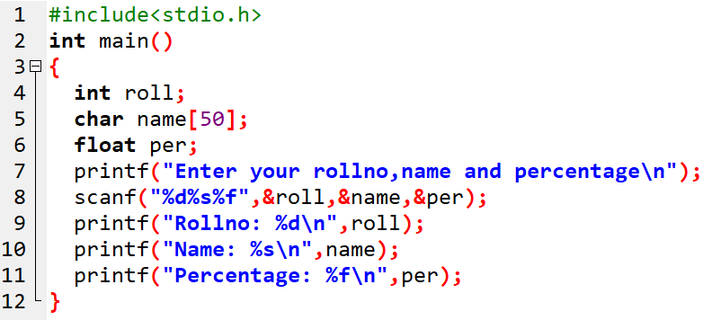
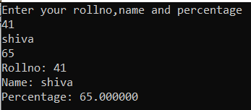
C

Slide 4
Variables
A variable in C is a named memory location used to store data.
Declaring Variables:
To declare a variable, specify the data type followed by the variable name.
int age;
float height;

Slide 5
Variables
Initializing Variables:
Assigning an initial value to a variable at the time of declaration.
int age = 25;
float height = 5.9;

Slide 6
Rules for writing Variable names:
Must begin with an alphabet or underscore
It can be of alphabets or alphanumeric.
The uppercase and lowercase letters are distinct/different, hence cannot be interchangeable. Eg; Total is not same as total.
Only 31 characters are significant.
It must not contain white space (blank) in between. But underscore(_) is accepted to join.
The keywords are not allowed as variable names.

Slide 7
Variables
Scope and Lifetime:
Global Variables: Declared outside of functions, accessible throughout the program.
Local Variables: Declared inside functions or blocks, only accessible within that scope.

Slide 8
Data Types
A datatype refers to the type of data that can be stored in a variable.
Datatype
Fundamental Datatype
Integers
Floating Point
Character
Derived Datatype
User Defined Datatype

Slide 9
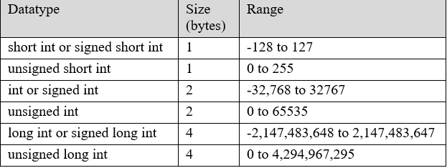

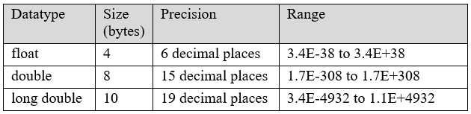
Data Types
Fundamental datatypes: integer, floating point, and character
i) Integer Datatype
iii) Character Datatype
ii) Floating point
Datatype

Slide 10
Data Types
Derived Data Types: Created using Fundamental Data Types
Array: Collection of elements of the same data type, accessed by index.
Pointer: Holds the memory address of another variable.
Structure: Allows grouping of variables of different types.
Union: Similar to structures but shares memory for all members, saving space.

Slide 11
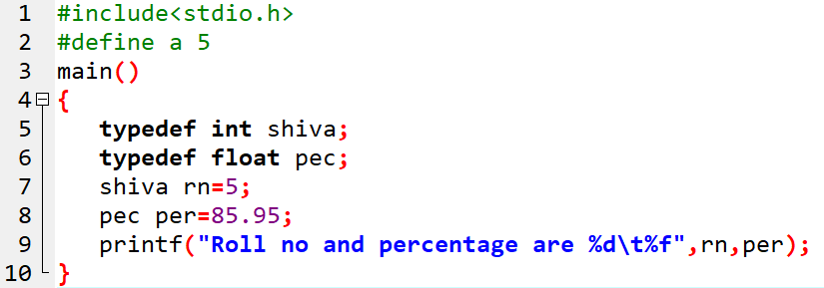
Data Types
User Defined Data Types:
Defined by user for their simplicity.
Done by using typedef or enum keywords.

Slide 12
C Operators
An operator is a symbol that tells the compiler to perform a certain mathematical or logical manipulation.
Operators are used in programs to manipulate data and variables.
Eg: sum= a+b;
Here, + and = are operators, and sum, a, and b are operands.

Slide 13
C Operators
Types of operator | Symbols used
Arithmetic | + - * / %
Relational | < > <= >= == !=
Logical | && || !
Assignment | = += -= *= /= %=
Increment/decrement | ++ --
Conditional | ? :
Bitwise | & | ^ << >>
Special | & * sizeof()

Slide 14
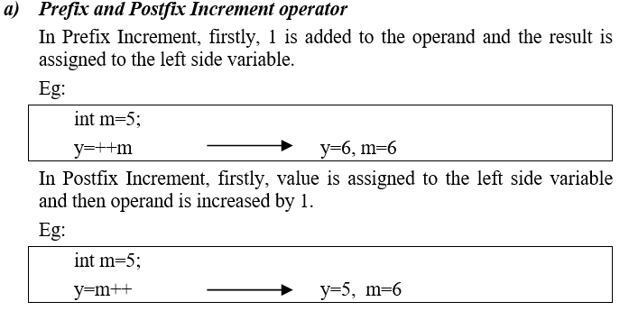
Increment and Decrement Operator

Slide 15
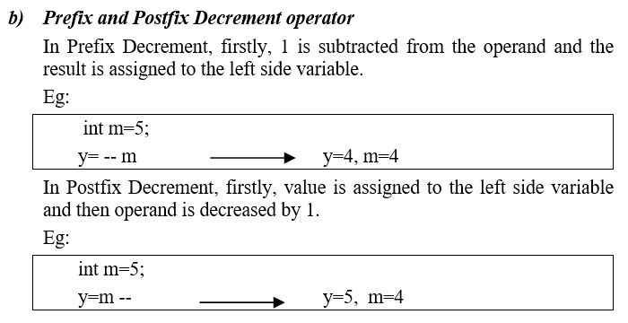
Increment and Decrement Operator (Contd.)

Slide 16
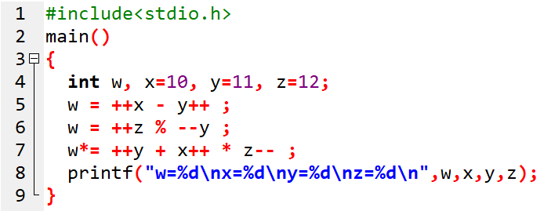
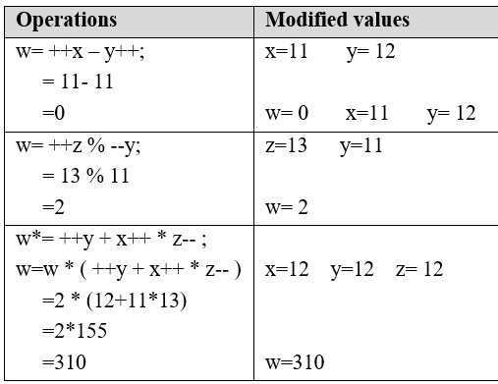
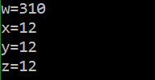
Increment and Decrement Operator (Contd.)
Find the output of below:
Working note:
Output:

Slide 17
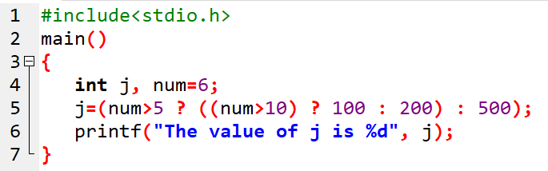

Conditional operator
What will be the output of below program?
Output

Slide 18
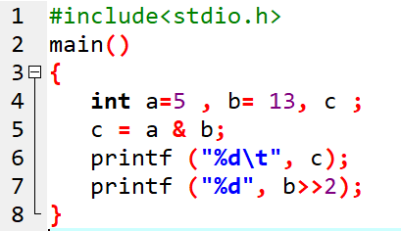
Bitwise operator
What will be the output of below program?
Output:

Slide 19
Types of operators
On the basis of number of operands:
Types | Examples
Unary | a++ a+=1
Binary | X= a+b if (a>b)
Ternary | x = (num> 0 ?”Positive” : “Negative”

Slide 20
3.12 Precedence and Associativity of operators
Precedence : which operator to evaluate first
Associativity: which one to operate first when having same precedence
Category | Operator | Associativity
Postfix | () [] -> . ++ -- | Left to right
Unary | ! ~ + - ++ - - & * sizeof (type) | Right to left
Arithmetic | * / % + - | Left to right
Shift operators | << >> | Left to right
Relational | < <= > >= == != | Left to right
Bitwise operators | & ^ | | Left to right
Logical operators | && || | Left to right
Conditional | ?: | Right to left
Assignment | = *= /= %= += -= &= ^= |= <<= >>= | Right to left

Slide 21
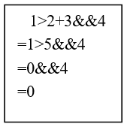
Evaluate: 1>2+3&&4
Solution

Slide 22
3.13 Expressions
An expression statement consists of an expression followed by a semicolon.
For e.g:
sum=x+y; //simple expression
x= (4*PI*pow(r,3))/3; //complex expression

Slide 23
3.14 Header files
SN | Header files | Purpose
1 | stdio.h | Used for performing Input/Output operations
2 | string.h | Used for string manipulation
3 | math.h | Handles mathematical functions
4 | stdlib.h | For general utilities like memory management, string handling, etc.
5 | conio.h | For Console Input/Output
6 | graphics.h | For using graphics in the program
A Header file is a standard file that contains definitions of variable and functions that are necessary for the functioning of a program.
We use #include directive to import header files

Slide 24
3.15 Format specifiers
characters starting with % sign
Tells compiler what type of data to take.
S.N | Datatype | Format Specifier
1. | int or short int | %d or %i
2. | long int | %ld
3. | unsigned int | %u
4. | unsigned long int | %lu
5. | float | %f
6. | double | %lf
7. | long double | %Lf
8. | char | %c
9. | string | %s

Slide 25
3.16 Escape Sequence Characters
Escape Sequence | Meaning
\a | Alarm or Beep
\b | Backspace
\n | New Line
\t | Tab (Horizontal)
\v | Vertical Tab
\\ | Backslash
\' | Single Quote
\" | Double Quote
\? | Question Mark
\0 | Null
starts with backslash \.
Have some special meaning

Slide 26
3.17 Simple I/O Functions
Functions used for input and output operations
scanf() : used to get input from the user and store in a variable.
scanf("format string", &variable);
%d for integer input
%f for float input
%s for string input (without spaces)
printf() : to display message or output.
printf("format string", variable);
%d for integers
%f for floats
%c for characters
%s for strings

Slide 27
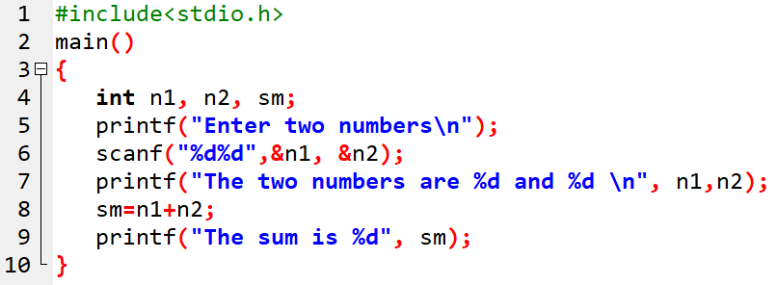
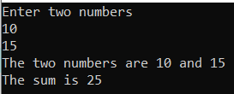
Sample program
Header file
Hea
variables
Escape sequence characters
Operator
Format Specifiers

Slide 28
3.18 Type Casting (Contd.)
Technique of changing one datatype into another type.
Two types:
Implicit conversion
Explicit conversion

Slide 29
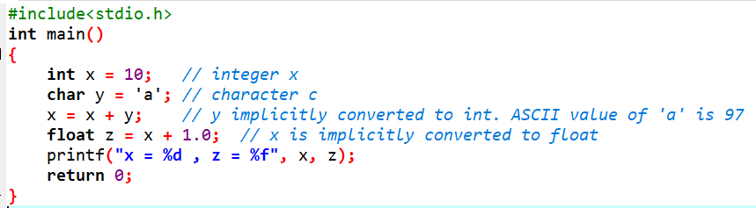

3.18 Type Casting (Contd.)
Technique of changing one datatype into another type.
Two types:
Implicit conversion
Explicit conversion

Slide 30
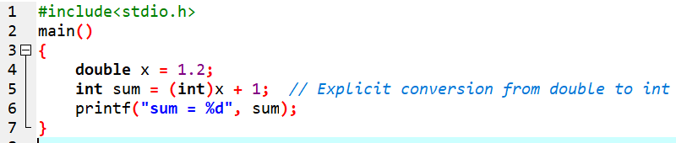

3.18 Type Casting (Contd.)

Slide 31
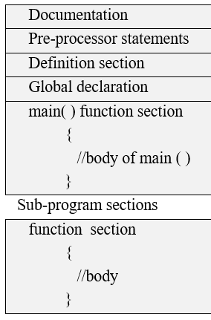
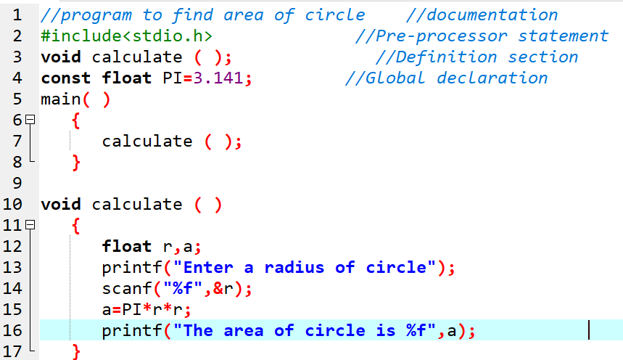
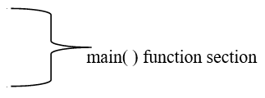
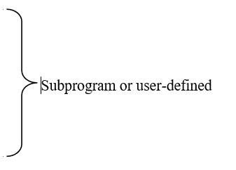
3.19 Basic Structure of C program

Slide 32

3.20 Some Sample Programs

Slide 33
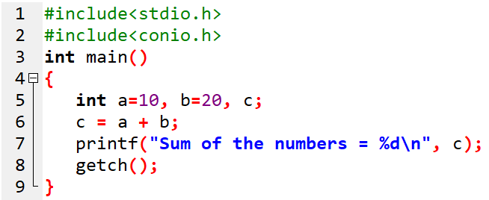
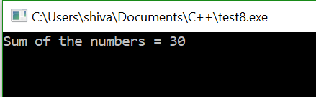
1. WAP to read two numbers and add them.

Slide 34
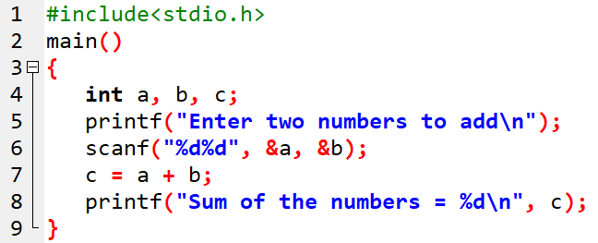
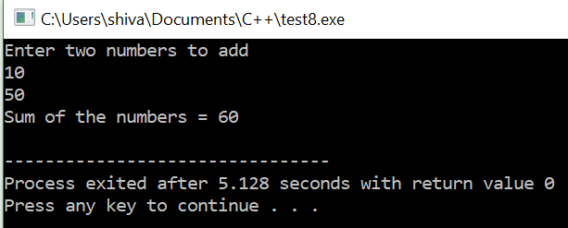
2. WAP to accept two numbers form user and find their sum.

Slide 35
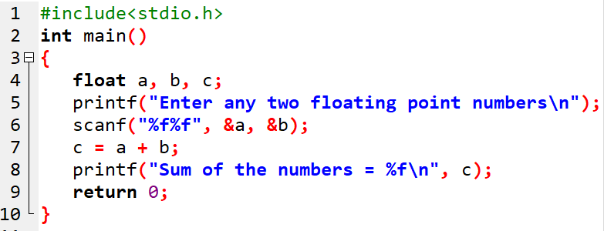
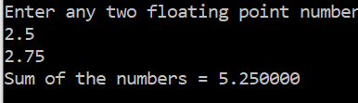
3. WAP to enter any two decimal numbers and find their sum.

Slide 36
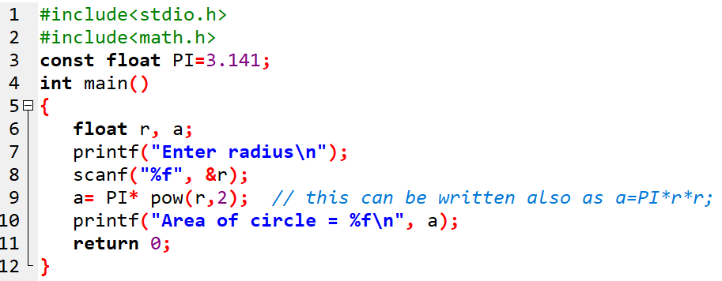
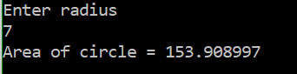
4. WAP to enter radius and find the area of circle.

Slide 37
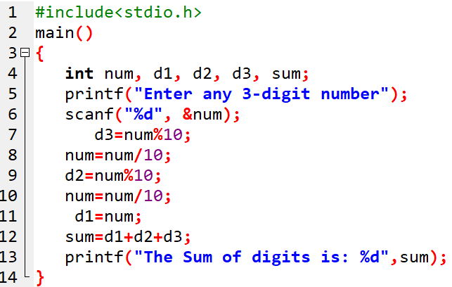
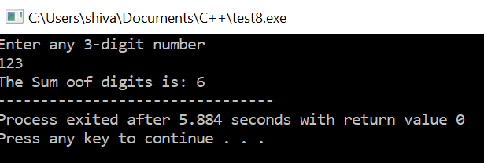
5. WAP to enter any 3-digit integer and find the sum of individual digits in it.

Slide 38
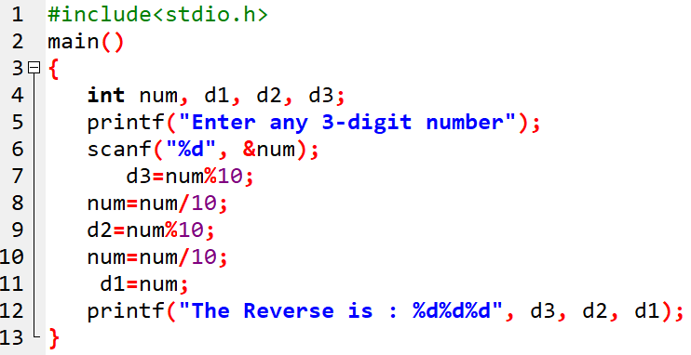
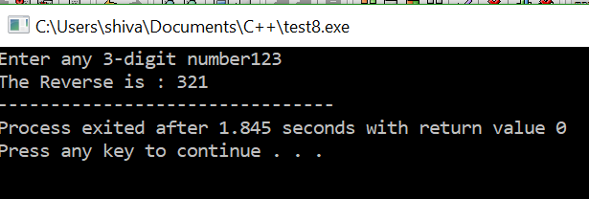
6. WAP to enter any 3-digit integer and display it in reverse order.

Slide 39
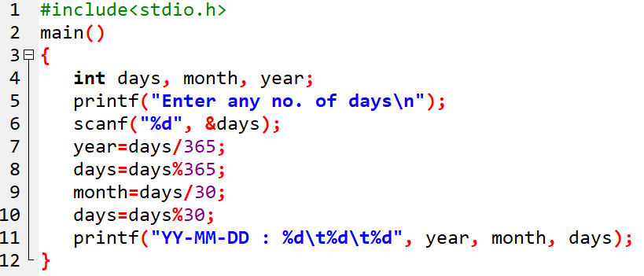
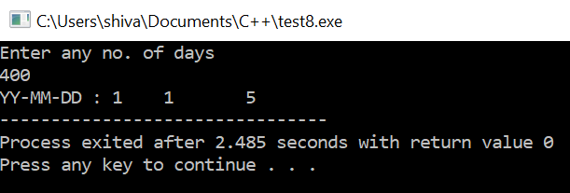
7. WAP to ask no. of days and then change it into years, month and days.

Slide 40
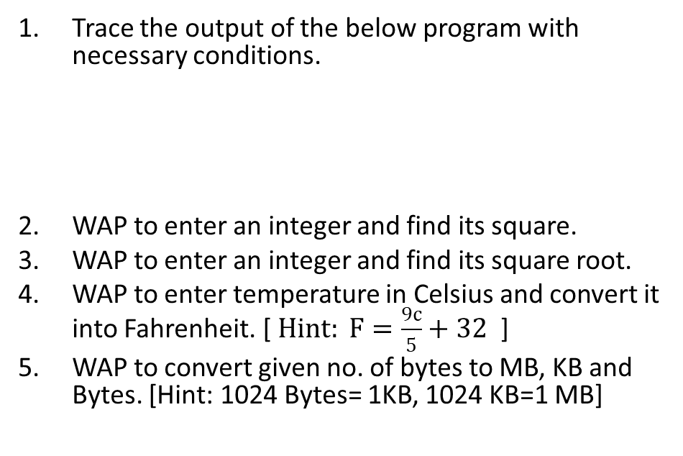
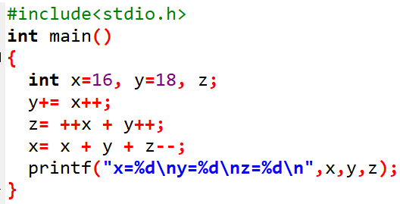
Assignment:

Slide 41
End of Lecture 6

Slide 42
Control Structures

